Slide 1

Got Sleep?
By Free Knowledge Mission

Slide 2
Disclaimer
Don’t take my word for it
Consultant with your physician or neurologist

Slide 3
Why?
Time is a greatest asset
Increase your productivity from an average of 16 hours a day to 22 hours.
That’s three months a year
15 years an average lifetime.
Energy
Peacefulness
Get your individual work done in the middle of the night
Disadvantage
Conflicts with society’s monophasic schedules
#1 reason people are unable to adopt

Slide 4
Examples
Biphasic (Siesta) – Latin, Mediterranean, Southern Europe cultures
Babies & Retirees
Militia
Astronauts
Animals
Mad Scientists
Nicola Tesla
Iron Man

Slide 5
Sleep Health
How much sleep are you getting?
Average people sleep 6-8 hours a night
Insomnia
Sleeplessness or sleep depravation
Sleep Apnea
Are you aware of your sleep patterns to your health
Monophasic and polyphasic have similar number REM cycles
Research is always being done. Most physicians & neurologist don’t recommend polyphasic.
Have you tried tracking your sleep patterns?
Similar to eating many meals a day
Smartwatch
Meditation & Mindfulness

Slide 6
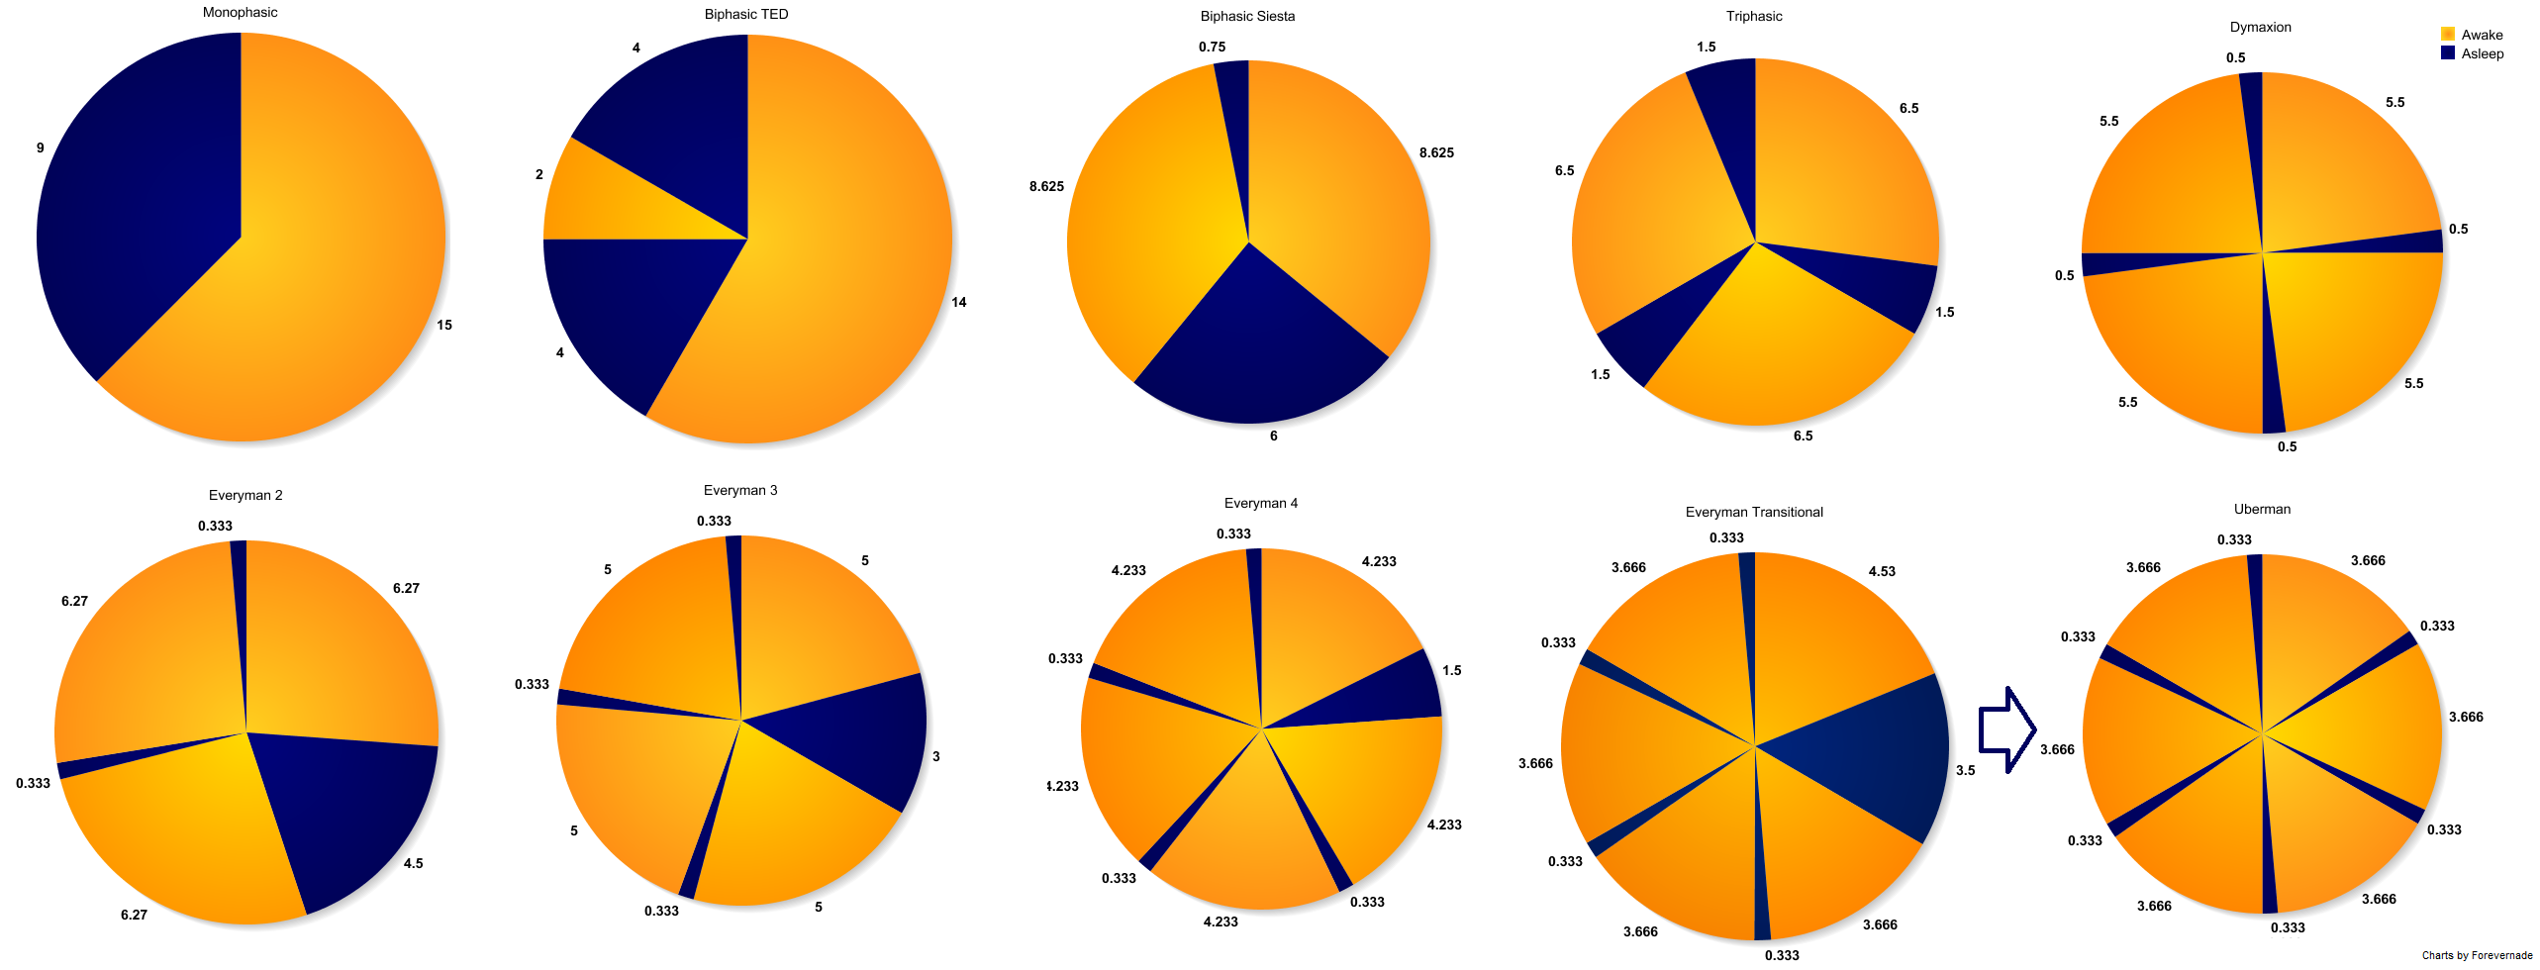
Schedules

Slide 7

Reading Inspiration
Limited published material
Check out Youtube videos
Google for blogs

Slide 8
Bottom Line
The hardest part is not napping but waking up after each nap.
There is what’s called adoption phase. It takes up two weeks of feeling like sleep deprivation before you don’t feel tired.
Passionately and purposefully busy
Energy – How’s your mitochondria levels; are you eating the proper foods?
The next time your boss asks you were you’ve been, tell him/her you were napping because you’re Uberman.

